Slide 1

Calling All Visitors

Slide 2


User Interface

Slide 3
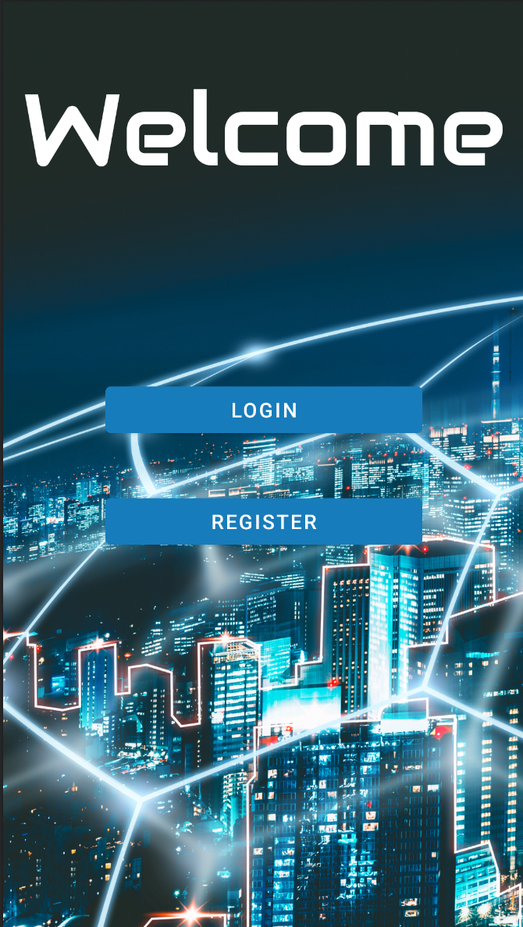
Welcome Page

Slide 4
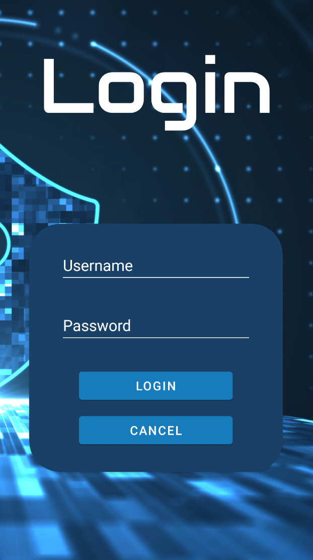
Login Page

Slide 5
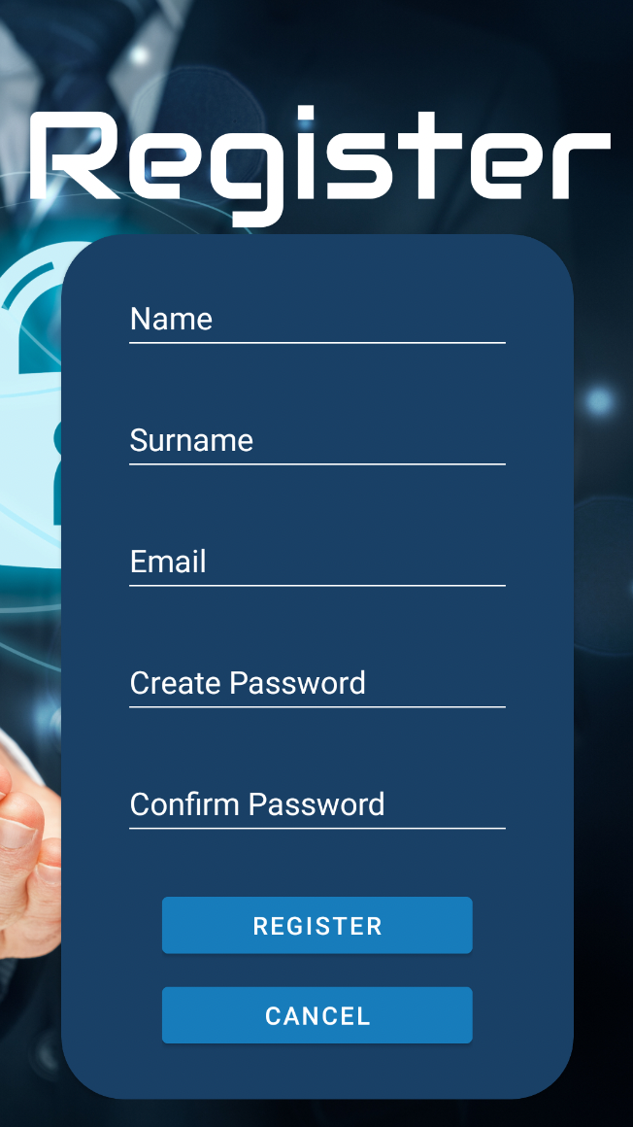
Register Page

Slide 6
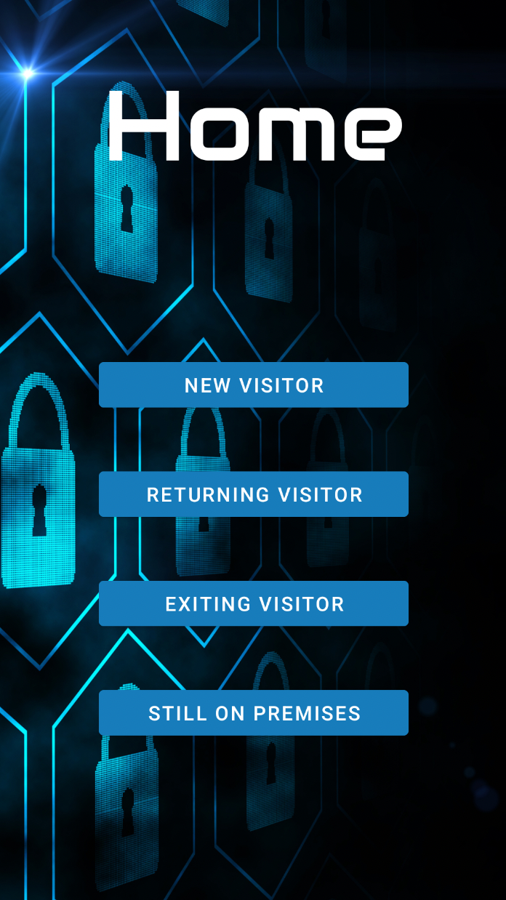
Home Page

Slide 7
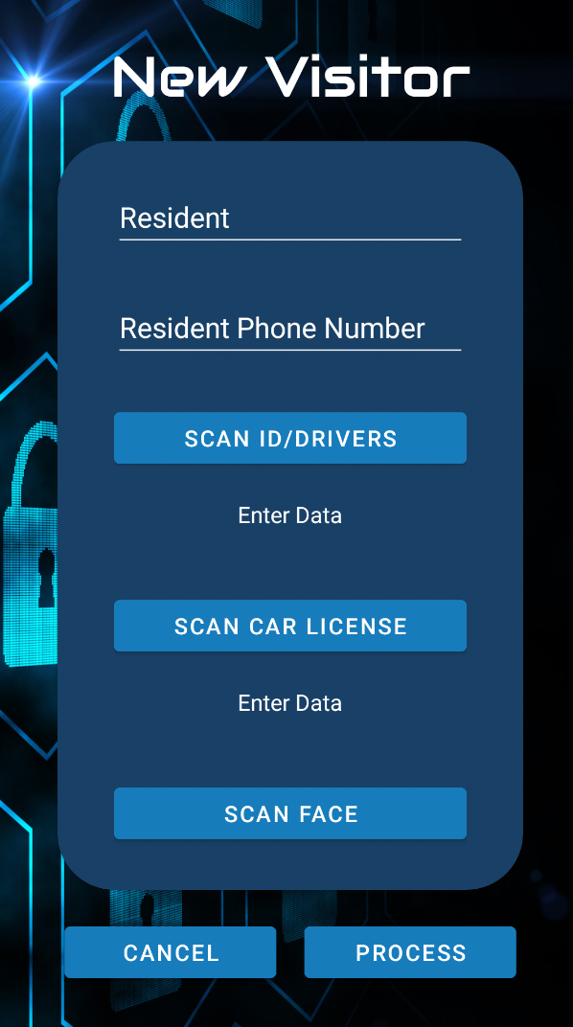
New Visitor Page

Slide 8
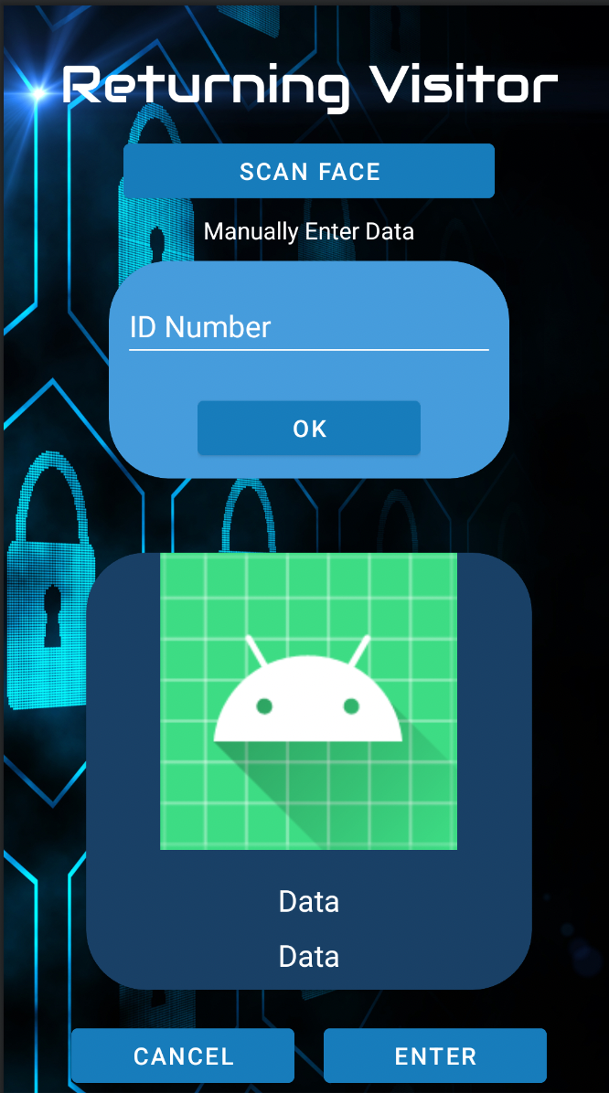
Returning Visitor Page

Slide 9
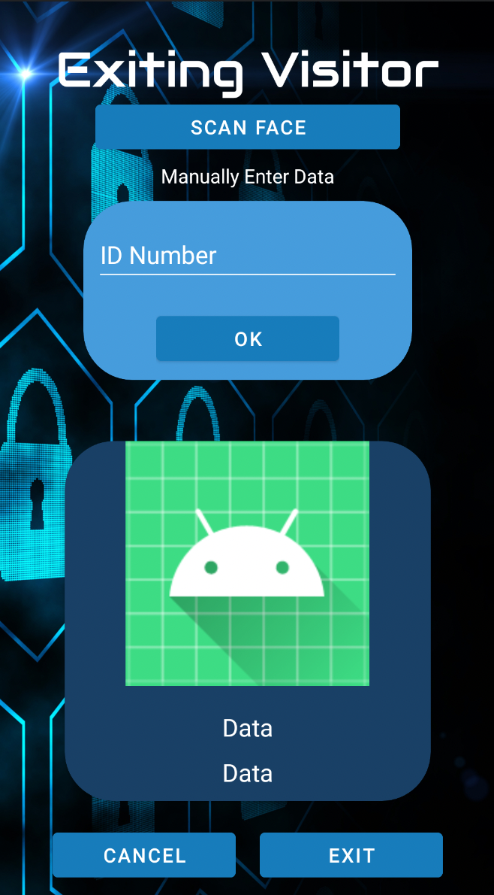
Exiting Visitor

Slide 10

Visitors On Premises

Slide 11

Problem
Current systems in the market is expensive to get, difficult to implement, needs constant maintenance
Smaller estates still use a paper system to keep track of visitors coming in and out.
With paper system you cannot see on demand if there are visitors still in the premises.
Paper systems is a tedious job if there are issues and you want to check the log

Slide 12
How Call All Visitors Application Solves the Problem
Professional visitor tracking for a fraction of the price of other systems
Relatively inexpensive implementation
Easy to implement
Simple to use which means save on training times and costs.
Cloud based which means no on premises servers needed

